Slide 1
Requirement Modeling
MIA

Slide 2
Project
Lecture-Room Reservation System.
→ 1 object
→ 1 flow

Slide 3
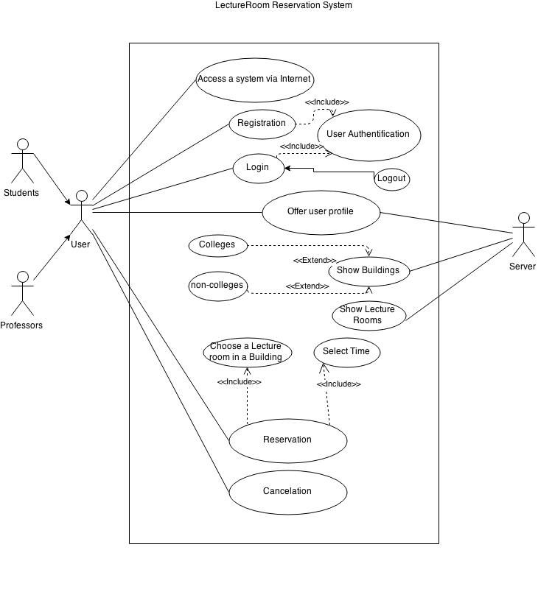
Behavior Model
By 1 use-case → 1 sequence

Slide 4
Pattern Model?
There’re any patterns.
Don’t use

Slide 5
For Web/Mobile Apps

Slide 6
Interaction Model
Use-case
State diagrams

Slide 7
Functional Model
Activity Diagram → Processing flow
Login
Select Room
Reserve

Slide 8
Navigation Model
How to get the reservation?
How to cancel the reservation?
➔ Server gives user some directions to reserve and cancel.
Notes:
To reserve, user should select the time which has no courses at the same time.
User may consist of two jobs. Student, Professor.
If a Student reserve a room, a professor can overwrite reservation in 24hr. (maybe)

